Slide 1









Course: Principal of Robotics
Course code: CSE-426
Faculty : Md Hafizul Imran
Tittle: Line Following Robot

Slide 2

Team Absolute Zero
Teammates
Name | ID | Section
Saiful Hasan 193-15-13507 B(54)
Shanta Naha 193-15-13385 B (54)
Tazan Rabbani 193-15-13441 B (54)
Tanvir Ahmed 193-15-13501 B (54)
Bijoy Biswas 193-15-13466 B (54)
Mahmud Ebne Zaman 193-15-13418 B (54)

Slide 3

Presentation Outline
Introduction
Components
Working Principle
Block Diagram
Application
Programming on Arduino
Advantages and Disadvantages

Slide 4
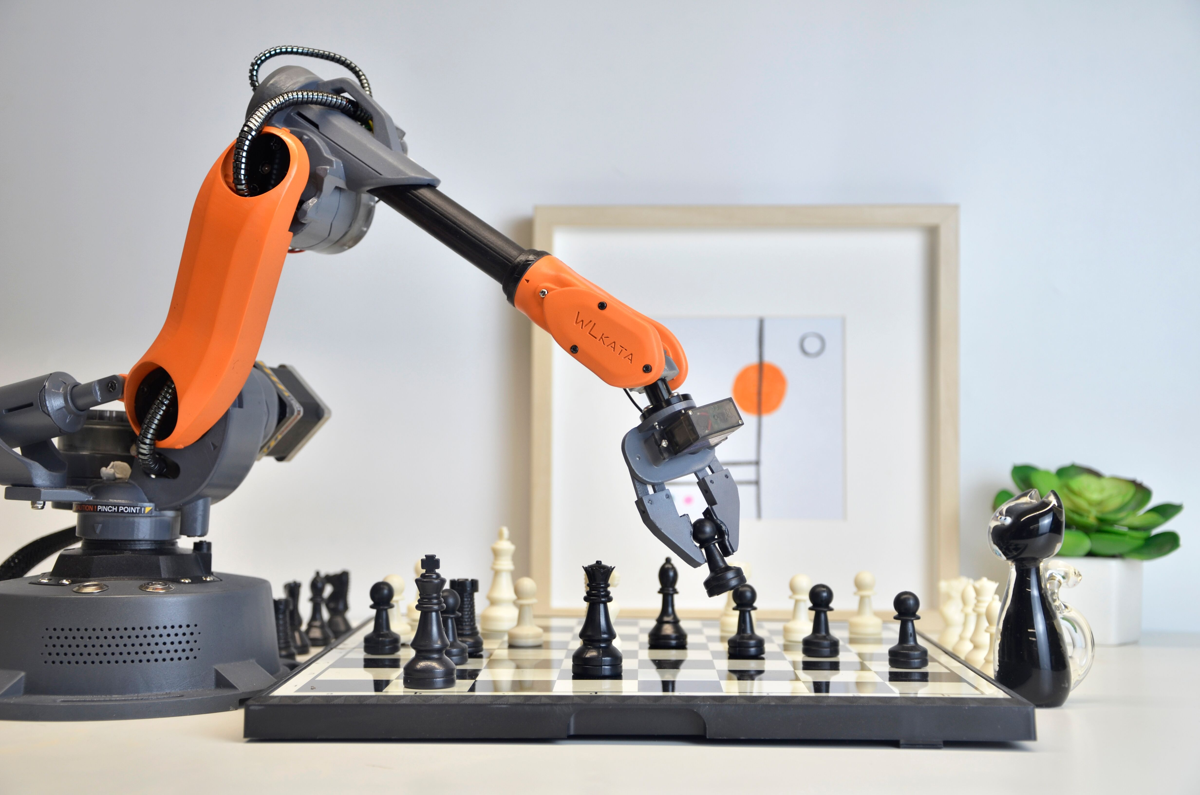
Introduction
A Robot is a machine capable of carrying out a complex series of actions automatically, especially one programmable by a computer.

Slide 5

Line Following Robot
What is a line following Robot?
The line follower robot is a mobile machine that can detect and follow the line drawn on the floor. Generally, the path is predefined and can be either visible like a black line on a white surface with a high contrasted color or it can be invisible like a magnetic field.

Slide 6
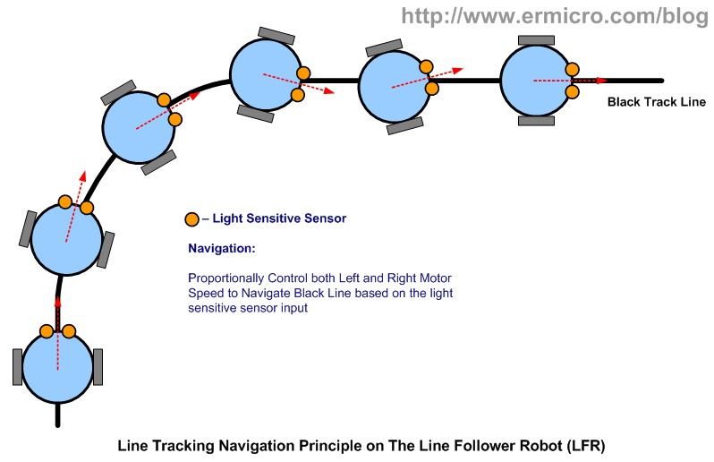
Line Following Robot
Sensing a line and maneuvering the robot to stay on course, while constantly correcting wrong moves using feedback mechanism forms a simple yet effective closed loop system.

Slide 7

Components
Arduino Uno(SDM)
IR Sensor(5 array)
Gear Motor
Motor Driver L298N
Wheel
Jumper wire set
4s lithium-ion Battery
Robot chassis(acrylic sheet)
Screw Nut
LFR Chassis

Slide 8

Arduino UNO
Arduino is an open-source computer hardware and software company, project and user community that designs and manufactures microcontroller-based kits for building digital devices and interactive objects that can sense and control objects in the physical world.

Slide 9
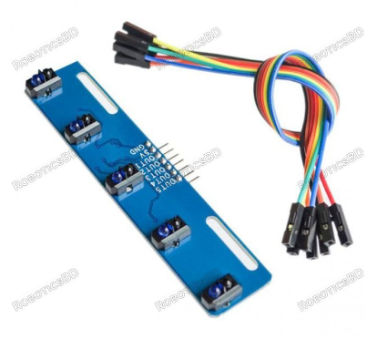
5 Array IR Sensor
A 5 IR sensor used with TCRT5000 has a compact construction where the emitting-light source and the detector are arranged in the same direction to sense the presence of an object by using the reflective IR-beam from the object. The operating wavelength is approx 5 cm. The detector consists of a phototransistor.

Slide 10
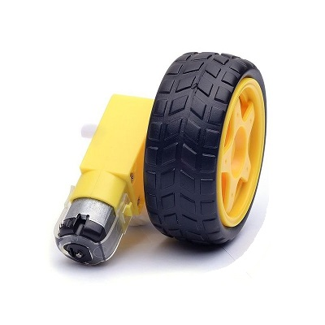
Gear Motor
A gear motor is a motor designed with an integrated gearbox. Gear motors function as torque multipliers and speed reducers thus requiring less power to move a given load. The design of the gearbox structure, type of gears, lubrication and type of coupling affects its performance.
The gear motor structure regulates whether the gear motor is suitable for light, medium or heavy loads and short or long operating periods. Depending on the internal gear structure and the reduction stages, the gear motor varies the speed on the output shaft. The reduction ratio is the ratio between the input speed and the output speed; therefore, it is one of the most important characteristic values of the gearbox. The power and load capacity of a gearbox depends on the maximum torque it is capable of transmitting and it is measured in the physical unit Newton meter [Nm].

Slide 11
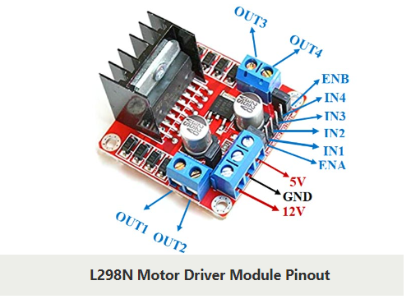
Motor Driver L298N
This L298N Motor Driver Module is a high power motor driver module for driving DC and Stepper Motors. This module consists of an L298 motor driver IC and a 78M05 5V regulator. L298N Module can control up to 4 DC motors, or 2 DC motors with directional and speed control.

Slide 12
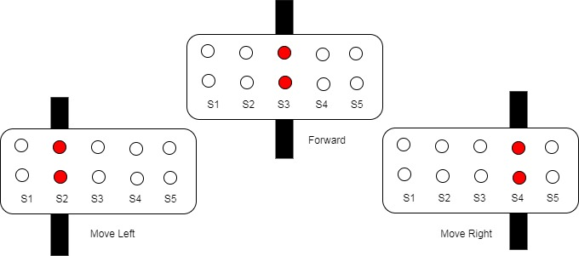
Working Principle
The IR sensor detects the light emitted by the transmitter, if the receiver receives light, the wheel of that side will keep on moving, as soon as the receiver stops receiving the light (black color absorbs the light and thus no light is reflected so receiver cannot receive any light) the wheel of that side will stop.
For turning ,the robot stops 1 motor and runs the second to make the turn possible. If the robot has to turn right then the motor on right side will stop and left motor will Keep on running and thus allowing the robot to turn.

Slide 13
Motor Logic
Sensor | Sensor | Sensor | Sensor | Sensor | Motion
1 | 1 | 0 | 1 | 1 | Forward
1 | 0 | 1 | 1 | 1 | left
0 | 1 | 1 | 1 | 1 | left-left
1 | 1 | 1 | 0 | 1 | right
1 | 1 | 1 | 1 | 0 | right-right
1 | 1 | 1 | 1 | 1 | out of track

Slide 14
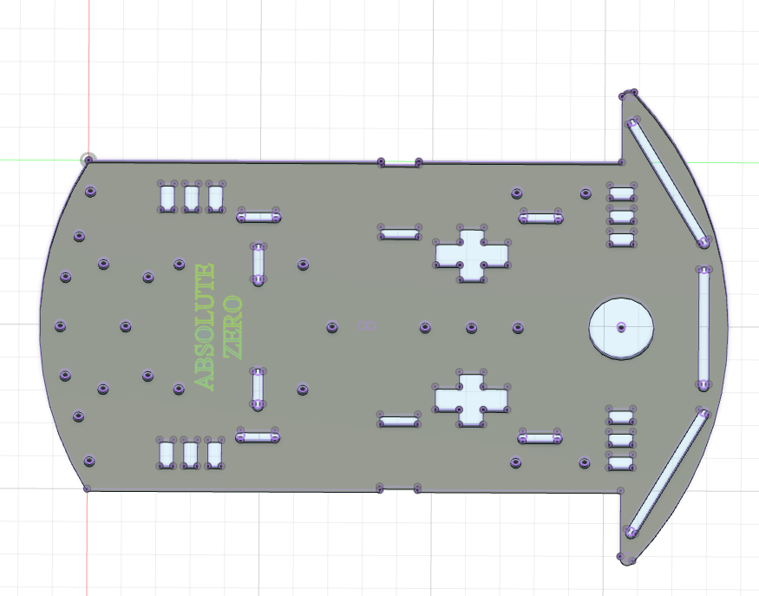
Chassis Design

Slide 15
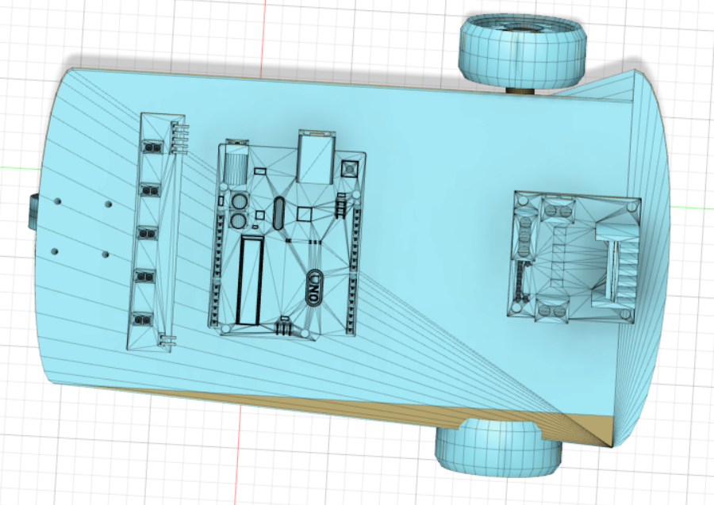
Prototype Design(2d)

Slide 16
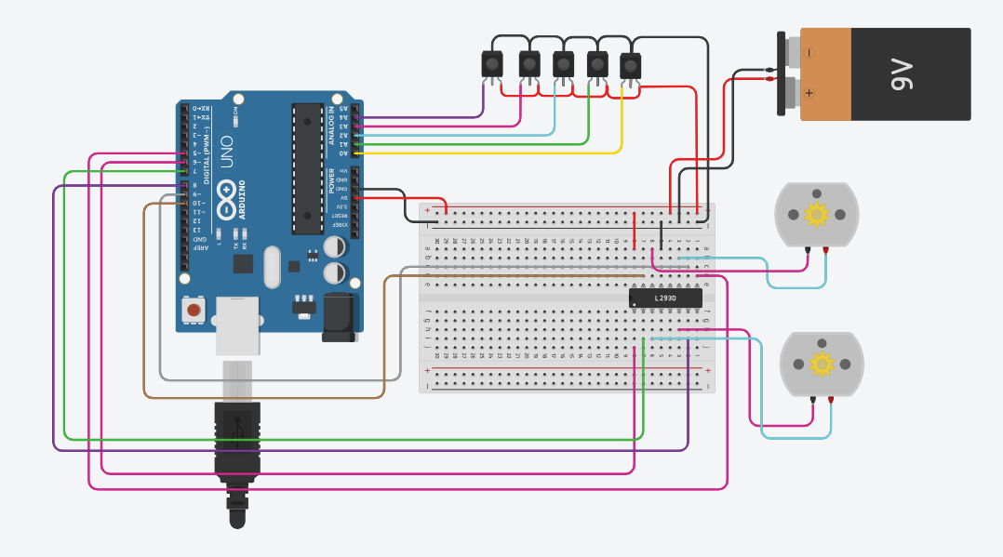
Circuit Diagram

Slide 17
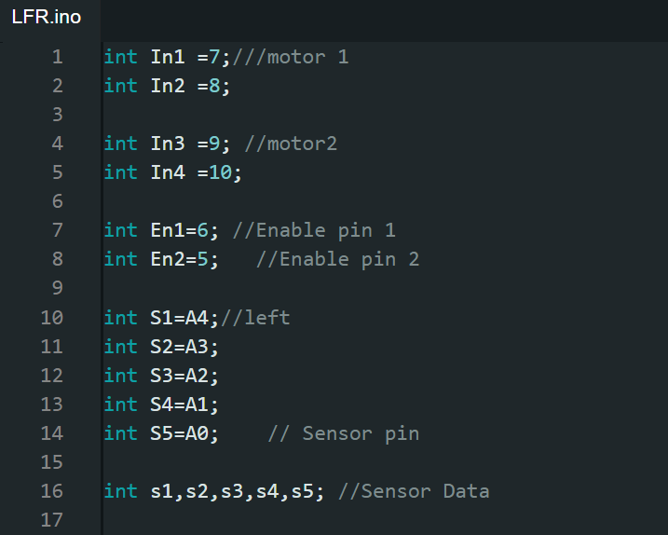
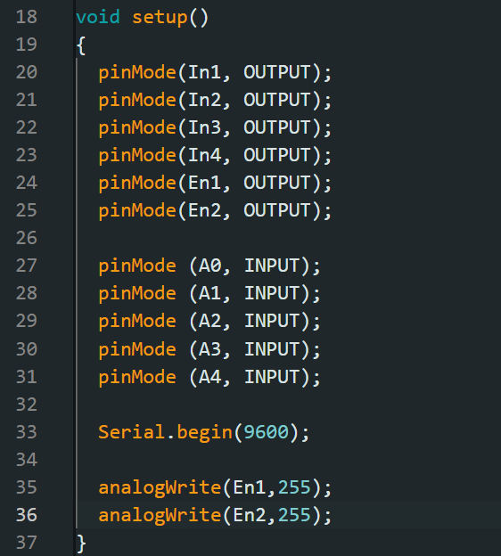
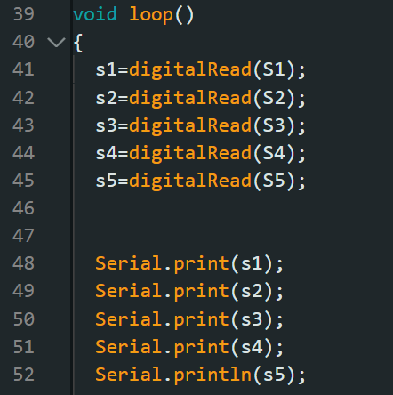
Code
Coding

Slide 18
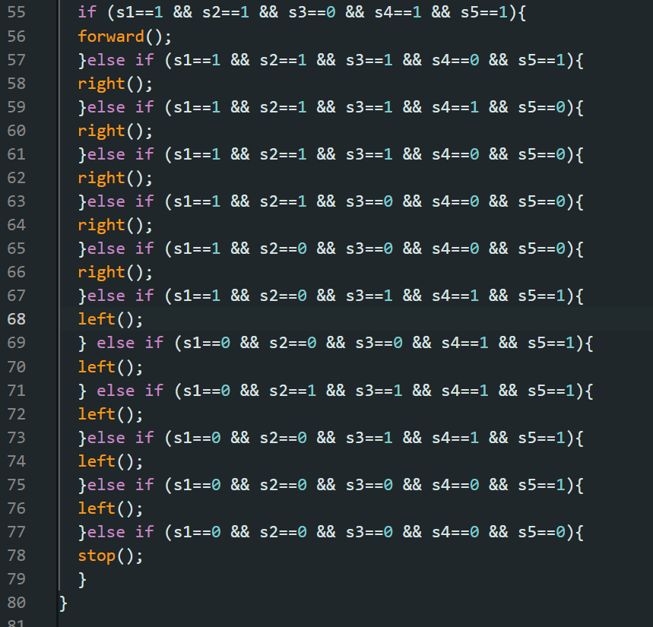
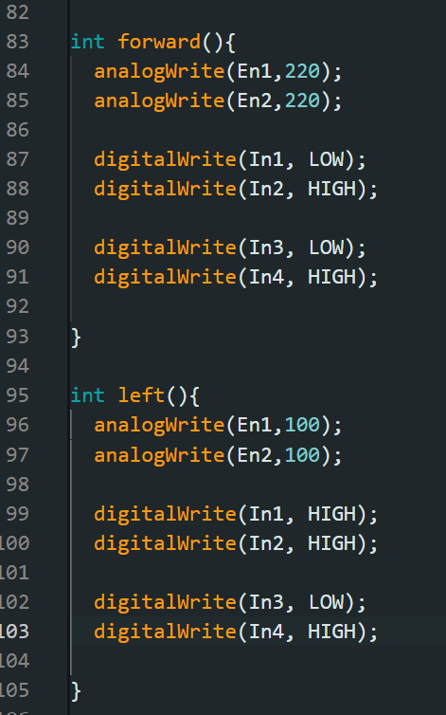
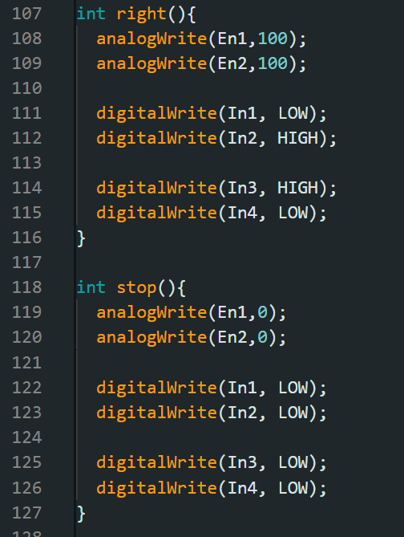
Code
Coding (Contd.)

Slide 19
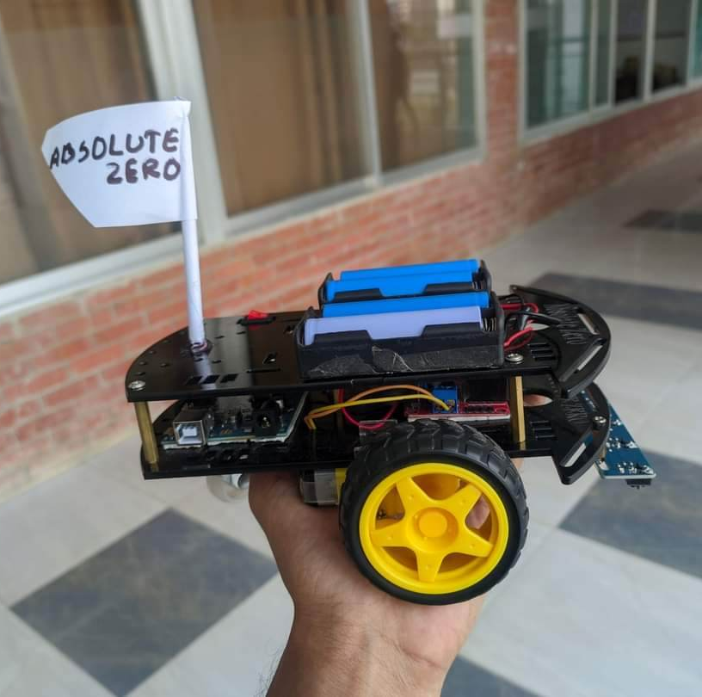
Presentation Link
Drive Link: https: https://drive.google.com/drive/folders/10JAY-TPHBolbMNu5-Q4YABRq76vVVMEJ?usp=sharing
YouTube: https://youtu.be/55rQIYhElco

Slide 20

THANK
YOU

